Slide 1
ETL

Slide 2
Introduction
ETL stands for Extract, Transform and Load.
An ETL tool extracts the data from different RDBMS source systems, transforms the data like applying calculations, concatenate, etc. and then load the data to Data Warehouse system.
The data is loaded in the DW system in the form of dimension and fact tables.
ETL combines all the three database function into one tool to fetch data from one database and place it into another database.
Notes:
A data warehouse is a type of data management system that is designed to enable and support business intelligence (BI) activities, especially analytics. Data warehouses are solely intended to perform queries and analysis and often contain large amounts of historical data
Those sources include but are not limited to:
SQL or NoSQL servers.
Flat files.
Email.
Web pages.

Slide 3
ETL is used to integrate the data with the help of three steps Extract, Transform, and Load, and it is used to blend the data from multiple sources. It is often used to build a data warehouse.
In the ETL process, data is extracted from the source system and convert into a format that can be examined and stored into a data warehouse or any other system.

Slide 4
Extraction
Extract is the process of fetching (reading) the information from the database. At this stage, data is collected from multiple or different types of sources.
A staging area is required during ETL load. There are various reasons why staging area is required.
The source systems are only available for specific period of time to extract data. This period of time is less than the total data-load time. Therefore, staging area allows you to extract the data from the source system and keeps it in the staging area before the time slot ends.

Slide 5
Staging area is required when you want to get the data from multiple data sources together or if you want to join two or more systems together. For example, you will not be able to perform a SQL query joining two tables from two physically different databases.
Data extracted from source systems can be used in multiple data warehouse system, Operation Data stores, etc.
Notes:
An ODS has been described by Inmon and Imhoff (1996) as a subject-oriented, integrated, volatile, current valued data store, containing only detailed corporate data. A data warehouse is a documenting database that includes associatively recent as well as historical information and may also include aggregate data.

Slide 6
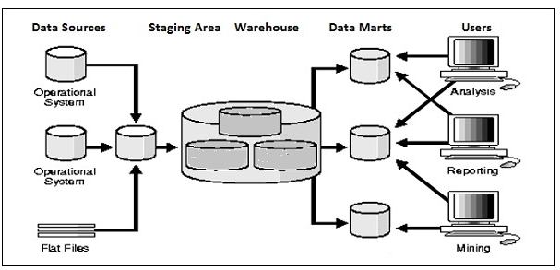
Notes:
A data mart is a simple form of data warehouse focused on a single subject or line of business. With a data mart, teams can access data and gain insights faster, because they don't have to spend time searching within a more complex data warehouse or manually aggregating data from different sources.

Slide 7
Transform
In data transformation, you apply a set of functions on extracted data to load it into the target system. Data, which does not require any transformation is known as direct move or pass through data.
Transform is the process of converting the extracted data from its previous form into the required form.
You can apply different transformations on extracted data from the source system.

Slide 8
For example, you can perform customized calculations. If you want sum-of-sales revenue and this is not in database, you can apply the SUM formula during transformation and load the data.
For example, if you have the first name and the last name in a table in different columns, you can use concatenate before loading.

Slide 9
Load
Load is the process of writing the data into the target database.
During Load phase, data is loaded into the end-target system and it can be a flat file or a Data Warehouse system.

Slide 10
Example
We are taking an example of a retail store which has different departments like sales, marketing, logistics, etc.
Each of them is handling the customer's information independently, and the way each department store the data is quite different.
Sales department stored it by the customer's name and marketing department store it by customer id.
Now, if we want to check the history of the customer and want to know what the different products he/she bought owing to various campaigns; it would be very tedious.

Slide 11
The solution for this is to use a data warehouse to store information from different sources in a uniform structure using ETL.
ETL tools extract the data from all these data sources and transform the data (like applying calculations, joining fields, removing incorrect data fields, etc.) and loads into a data warehouse.
ETL can transform unique data sets into a unified structure.

Slide 12
ETL Process
ETL is a three step process.
1. Extraction
In this step, data is extracted from the source system to the ETL server or staging area.
Transformation is done in this area so that the performance of the source system is not degraded.
If corrupted data is copied directly into the data warehouse from the source system, rollback will be a challenge over there.

Slide 13
Staging area allows validation of the extracted data before it moves in the data warehouse.
Validations during the extraction:
Confirm record with the source data
The data type should be checked
It will check whether all the things are in place or not
We have to be sure that no spam/unwanted data is loaded

Slide 14
2. Transformation
Extracted data from source server is raw and not usable in its original form. Therefore the data should be mapped, cleansed, and transformed.
Transformation is an important step where the ETL process adds values and change the data.
In this step, we apply a set of functions on extracted data. Data that does not require any transformation is called direct move or pass-through data.

Slide 15
Validation during the Transformation:
Filtering: For loading select only specific columns
For example, Age cannot be more than two digits
The required field should not be left blank.
3. Loading
Loading the data into the data warehouse is the last step of the ETL process.

Slide 16
The vast volume of data needs to load into the data warehouse for a concise time.
For increasing the performance, loading should be optimized.
If the loading fails, the recover mechanism should be there to restart from the point of the failure without data integrity loss.
Admin of data warehouse needs to monitor, resume, and cancel loads as per server performance.

Slide 17
OLTP & OLAP
Online analytical processing (OLAP) is a technology that organizes large business databases and supports complex analysis. It can be used to perform complex analytical queries without negatively affecting transactional systems.
The databases that a business uses to store all its transactions and records are called online transaction processing (OLTP) databases.
Notes:
Online Analytical Processing consists of a type of software tools that are used for data analysis for business decisions. OLAP provides an environment to get insights from the database retrieved from multiple database systems at one time. Examples – Any type of Data warehouse system is an OLAP system
Netflix movie recommendation system.
Online transaction processing (OLTP): Online transaction processing provides transaction-oriented applications in a 3-tier architecture. OLTP administers the day-to-day transactions of an organization.
Examples: Uses of OLTP are as follows:
ATM center is an OLTP application.

Slide 18
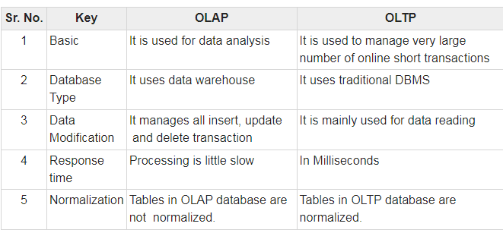
Notes:
OLTP or Online Transaction Processing is a type of data processing that consists of executing a number of transactions occurring concurrently—online banking, shopping, order entry, or sending text messages,
Use of olap:Sales reporting
Marketing
Management reporting
Process management
Budgeting
Forecasting

Slide 19
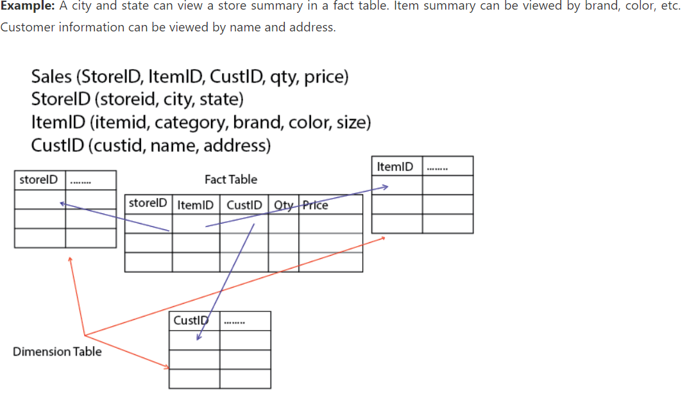
Dimension and fact tables

Slide 20
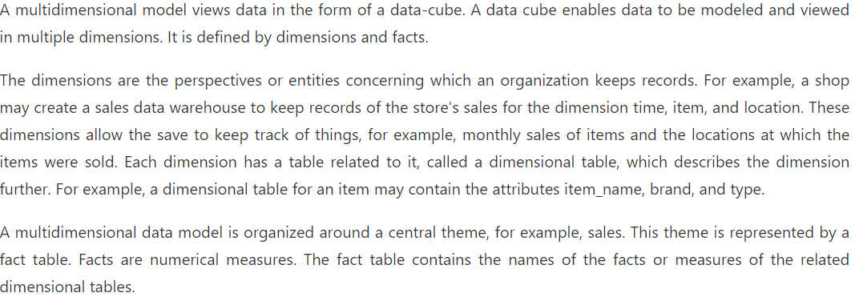
Multi dimensional model

Slide 21
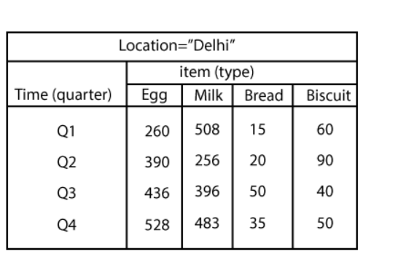
Data cube
Notes:
A data cube (also called a business intelligence cube or OLAP cube) is a data structure optimized for fast and efficient analysis.

Slide 22
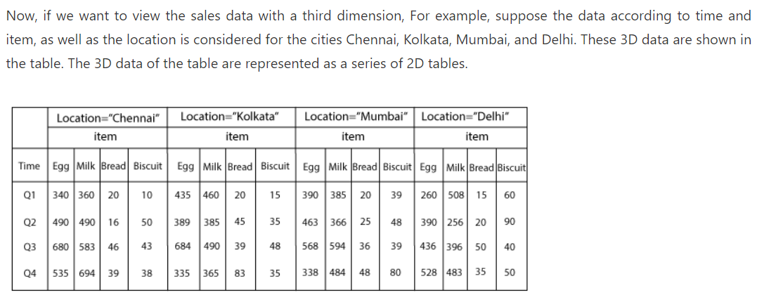

Slide 23
